Slide 1
Light as a Particle

Slide 2
Wave Phenomena
The wave nature of light has allowed us to explain and predict many of its behaviours, including:
Reflection
Refraction
Dispersion
Diffraction
Interference
Polarisation
But in 1887, a German physicist called Heinrich Hertz observed a phenomenon that the wave nature of light could not explain…

Slide 3
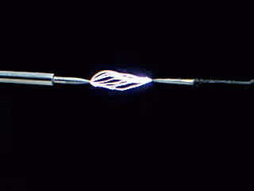
The Photoelectric Effect
Hertz was doing experiments with a spark gap: two electrodes a small distance apart from each other. Given sufficient voltage, a spark would jump from one electrode to the other (like a Van de Graaff generator).
Hertz noticed that shining a light on the negative electrode would increase the distance at which a spark could jump between the electrodes.
In the following years, it was discovered that the light was causing electrons to be ejected from the surface of the metal. The process was eventually named photoemission and the ejected electrons photoelectrons.
(Photoelectrons are just regular electrons – the name simply communicates what has happened to them.)

Slide 4
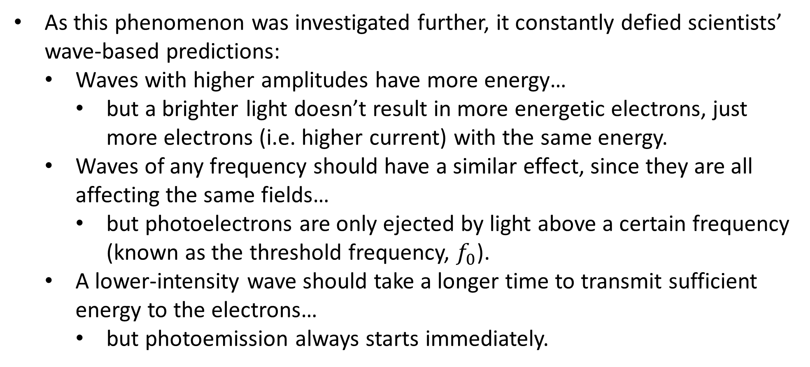
The Photoelectric Effect
As this phenomenon was investigated further, it constantly defied scientists’ wave-based predictions:
Waves with higher amplitudes have more energy…
but a brighter light doesn’t result in more energetic electrons, just more electrons (i.e. higher current) with the same energy.
Waves of any frequency should have a similar effect, since they are all affecting the same fields…
but photoelectrons are only ejected by light above a certain frequency (known as the threshold frequency, $f_{0}$).
A lower-intensity wave should take a longer time to transmit sufficient energy to the electrons…
but photoemission always starts immediately.

Slide 5
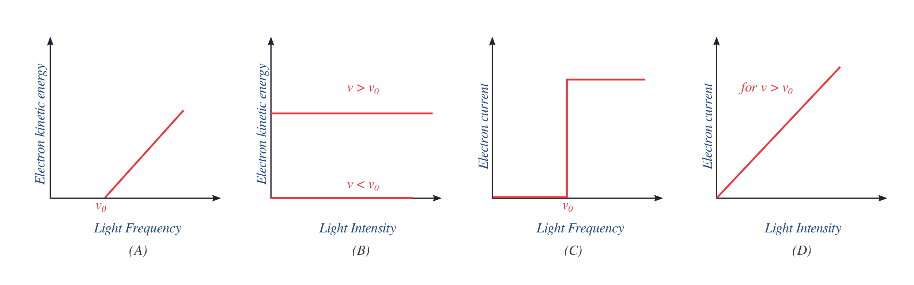

The Photoelectric Effect
Some of these observations can be represented visually (note that $v$ is used for frequency rather than $f$, and maximum kinetic energy is shown):
A: electrons are not emitted by light with $f<f_{0}$; above $f_{0}$, the electrons’ kinetic energy increases in a linear fashion as $f$ increases
B: the intensity of the light has no effect on electron kinetic energy
C: the frequency of the light (above $f_{0}$) has no effect on current
D: current is directly proportional to intensity as long as $f>f_{0}$

Slide 6
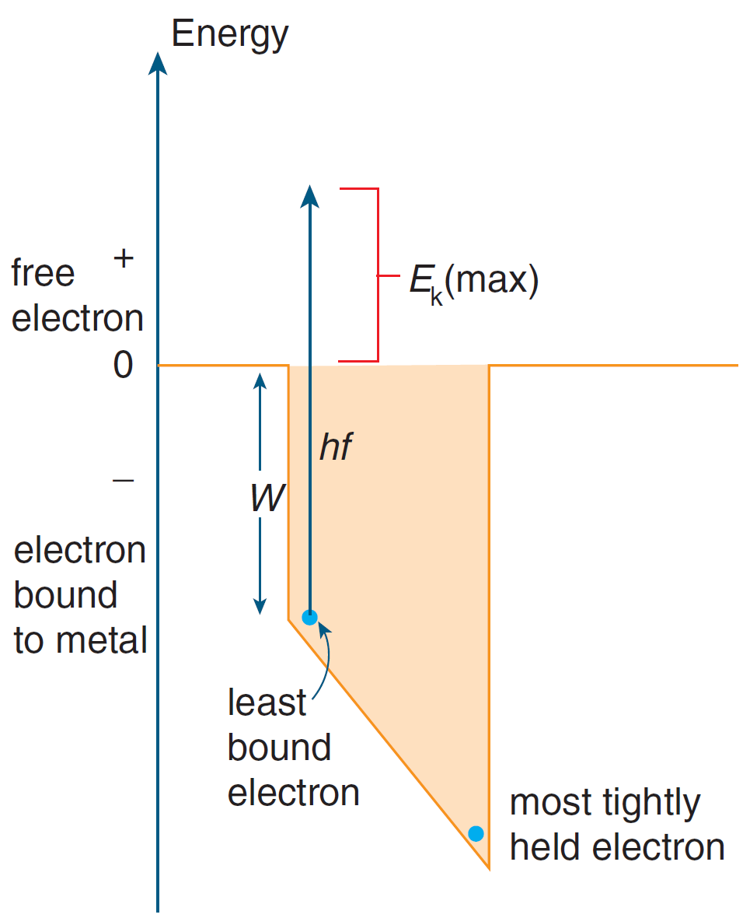
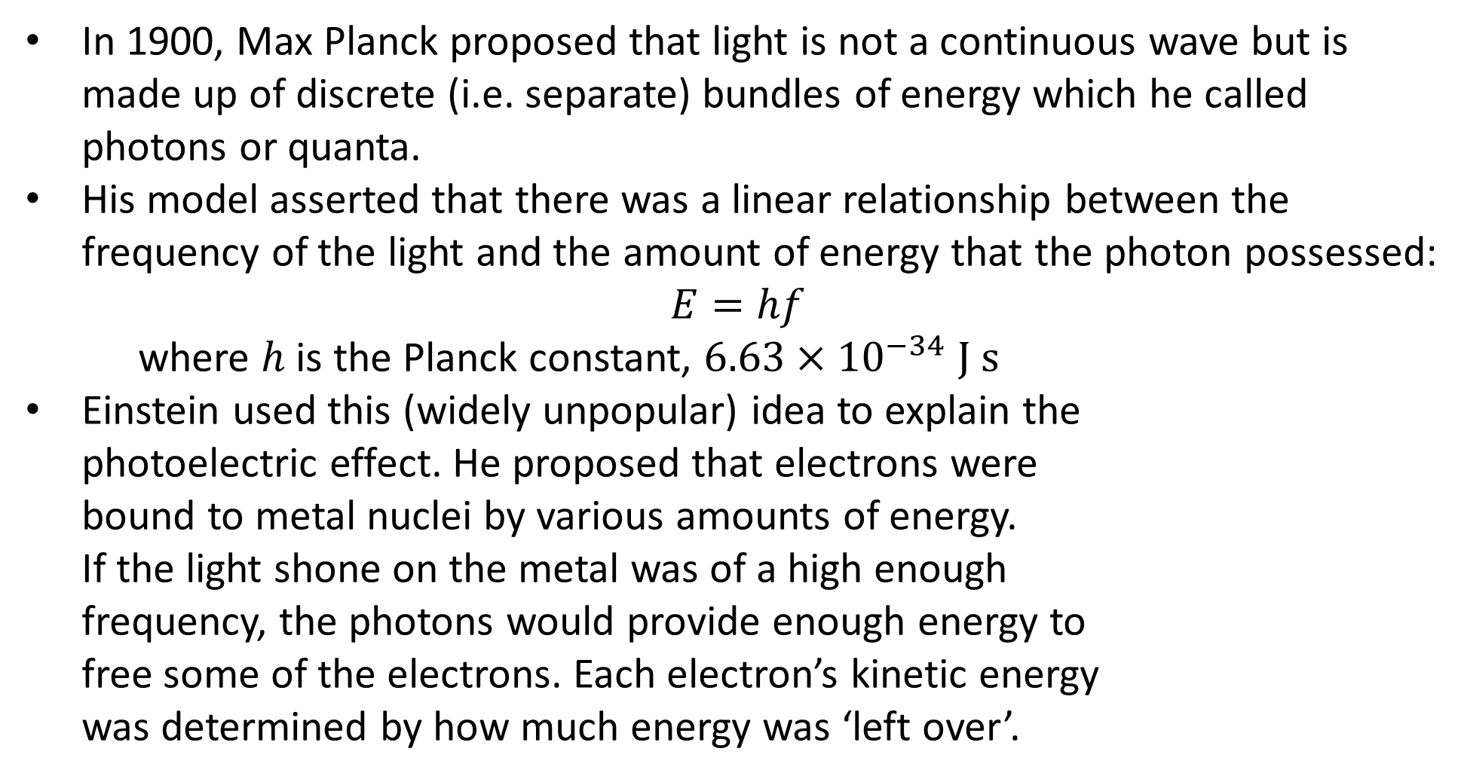
Photons
In 1900, Max Planck proposed that light is not a continuous wave but is made up of discrete (i.e. separate) bundles of energy which he called photons or quanta.
His model asserted that there was a linear relationship between the frequency of the light and the amount of energy that the photon possessed:
$$E=hf$$
where $h$ is the Planck constant, $6.63×{10}^{−34} \text{J} \text{s}$
Einstein used this (widely unpopular) idea to explain the photoelectric effect. He proposed that electrons were bound to metal nuclei by various amounts of energy. If the light shone on the metal was of a high enough frequency, the photons would provide enough energy to free some of the electrons. Each electron’s kinetic energy was determined by how much energy was ‘left over’.

Slide 7
Photons
This explanation solved many of the mysteries that had been encountered so far:
A brighter light doesn’t result in more energetic electrons, just more electrons (i.e. higher current) with the same energy…
because increasing the intensity of the light increases the number of photons, not each individual photon’s energy.
Photoelectrons are only emitted by light above the threshold frequency…
because below that frequency, the photons do not have enough energy to free the electrons from their nuclei.
Photoemission always starts instantaneously…
because each photon is absorbed by a single electron and transfers all of its energy at once (also Planck’s ideas).

Slide 8


Slide 9
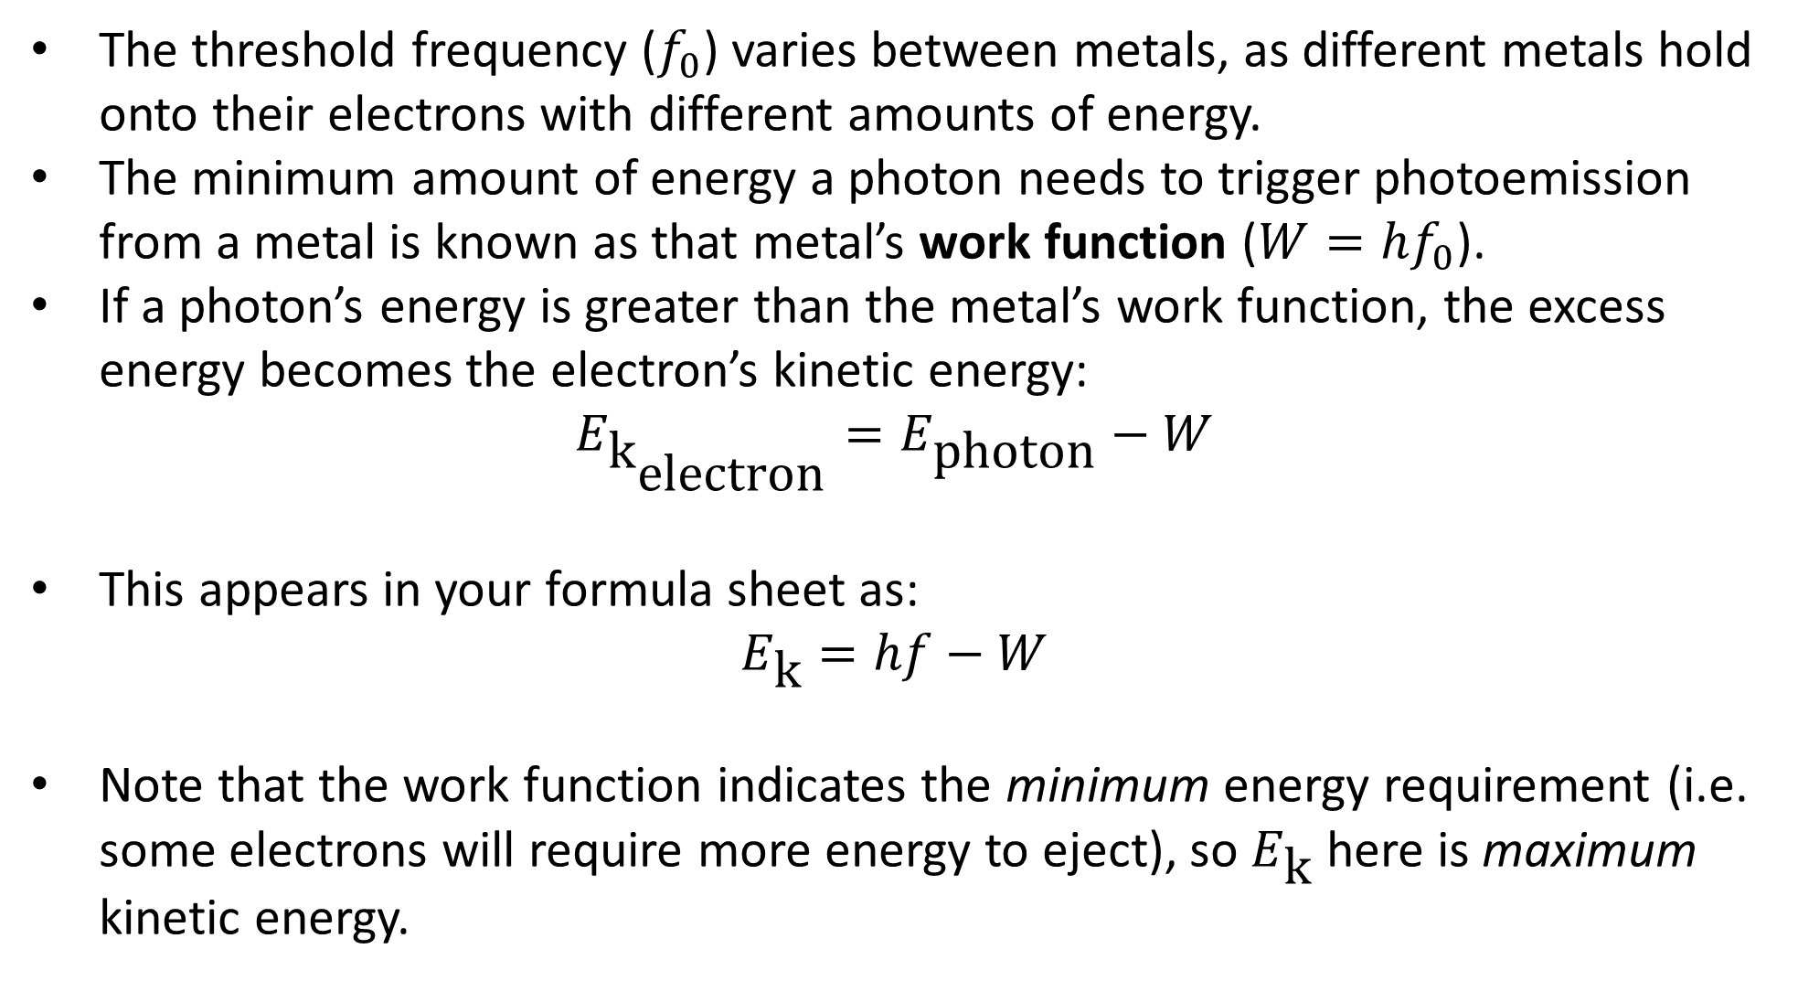
Energy Considerations
The threshold frequency ($f_{0}$) varies between metals, as different metals hold onto their electrons with different amounts of energy.
The minimum amount of energy a photon needs to trigger photoemission from a metal is known as that metal’s work function ($W=hf_{0}$).
If a photon’s energy is greater than the metal’s work function, the excess energy becomes the electron’s kinetic energy:
$$E_{{\text{k}}_{\text{electron}}}=E_{\text{photon}}−W$$
This appears in your formula sheet as:
$$E_{\text{k}}=hf−W$$
Note that the work function indicates the minimum energy requirement (i.e. some electrons will require more energy to eject), so $E_{\text{k}}$ here is maximum kinetic energy.
Notes:
Yes, it’s a weird use of the word function, and no, I couldn’t work out why it’s used in that way.
Work functions are typically measured in eV.

Slide 10
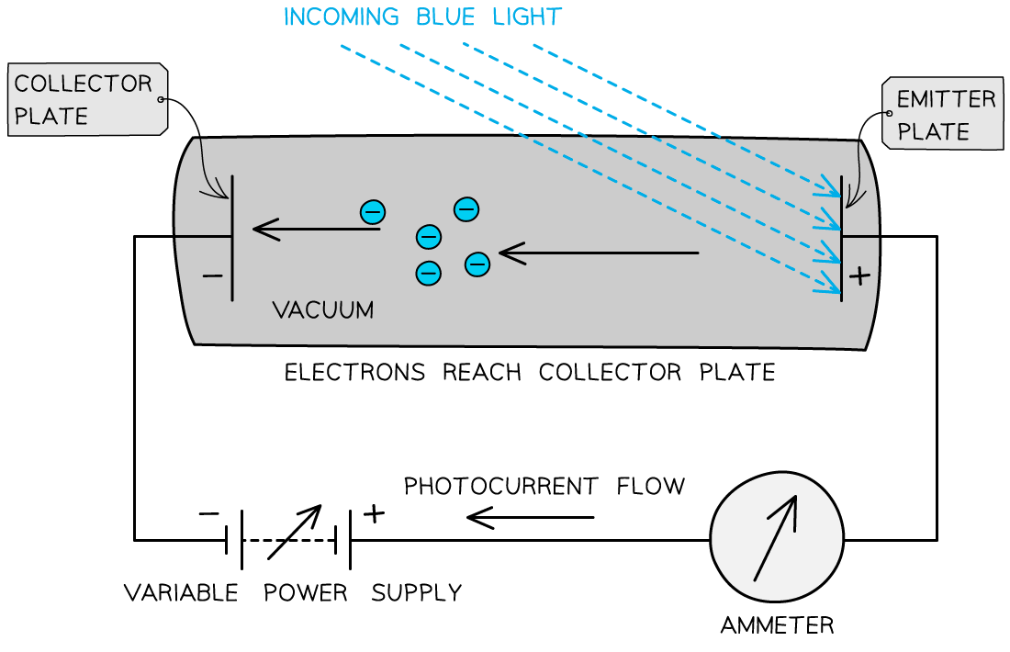
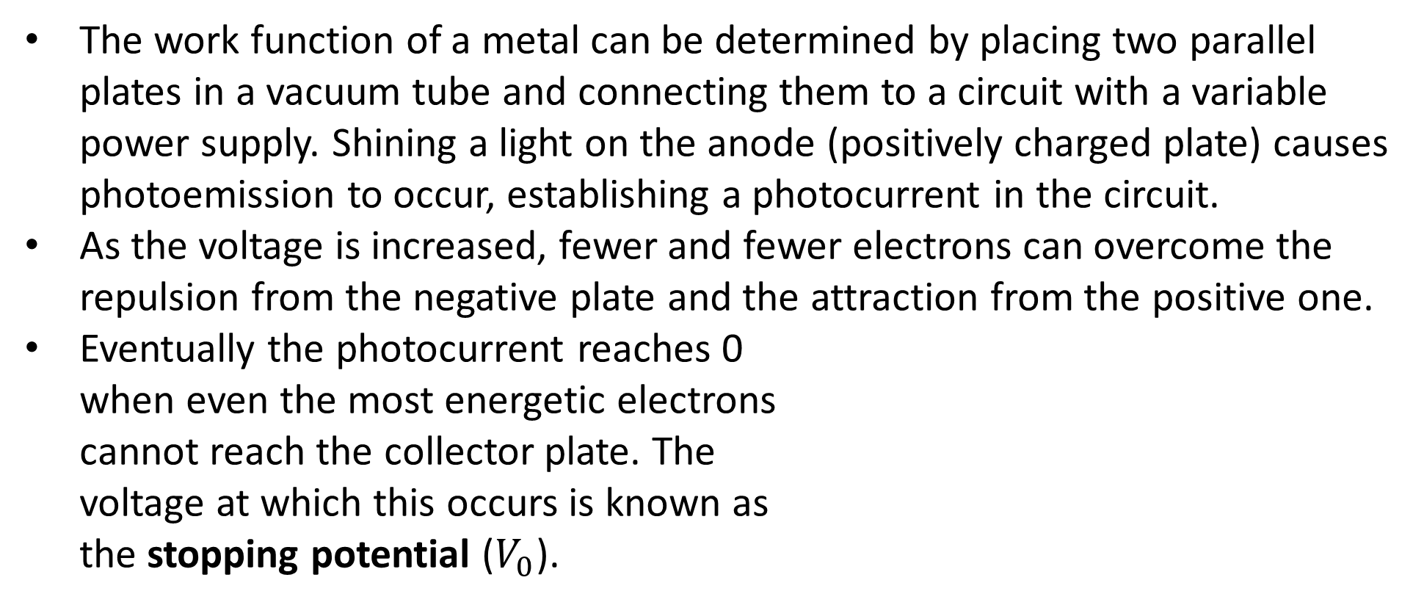
Stopping Potential
The work function of a metal can be determined by placing two parallel plates in a vacuum tube and connecting them to a circuit with a variable power supply. Shining a light on the anode (positively charged plate) causes photoemission to occur, establishing a photocurrent in the circuit.
As the voltage is increased, fewer and fewer electrons can overcome the repulsion from the negative plate and the attraction from the positive one.
Eventually the photocurrent reaches 0 when even the most energetic electrons cannot reach the collector plate. The voltage at which this occurs is known as the stopping potential ($V_{0}$).

Slide 11
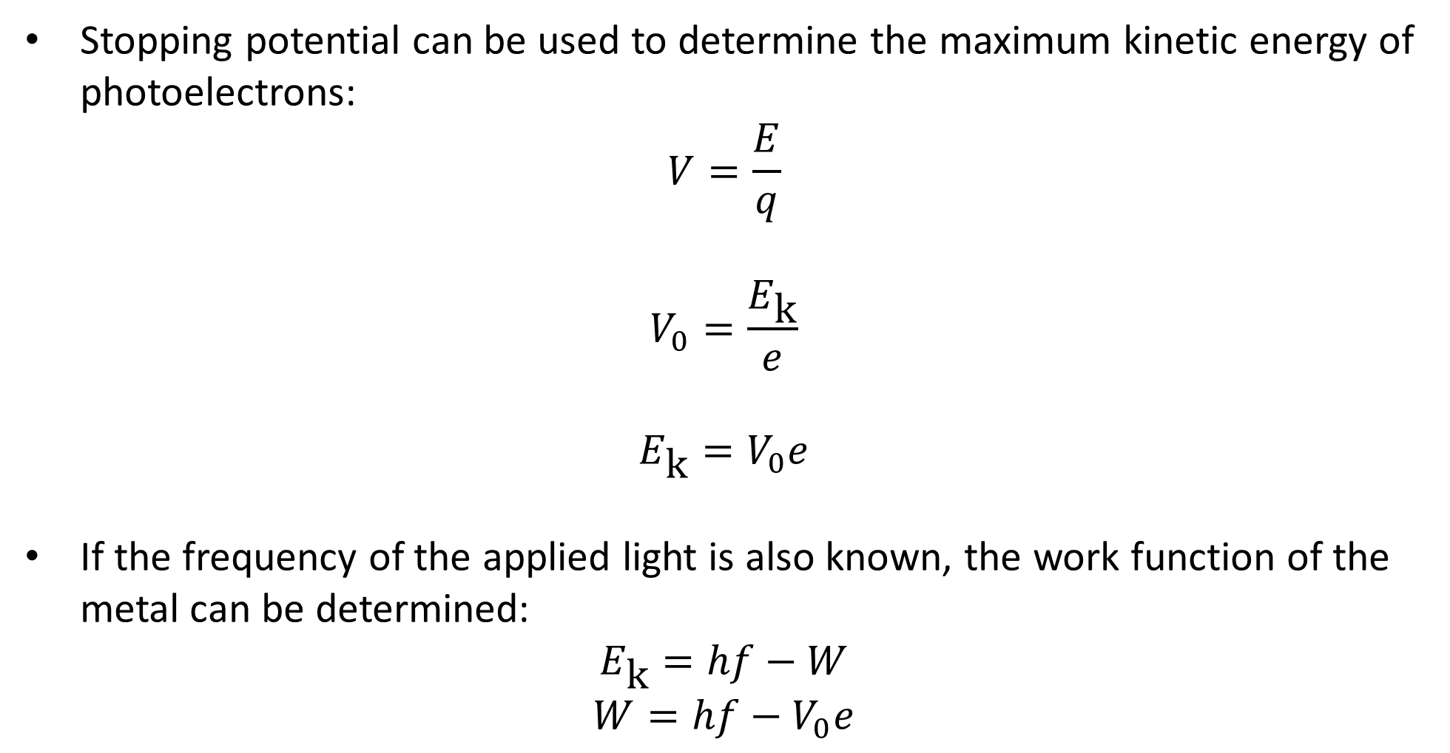
Stopping Potential
Stopping potential can be used to determine the maximum kinetic energy of photoelectrons:
$$V=\frac{E}{q}$$
$$V_{0}=\frac{E_{\text{k}}}{e}$$
$$E_{\text{k}}=V_{0}e$$
If the frequency of the applied light is also known, the work function of the metal can be determined:
$$E_{\text{k}}=hf−W$$
$$W=hf−V_{0}e$$
Notes:
Watch out: your formula sheet has an equation labelled “Work and energy”: W = Vq. That W is work (i.e. energy; electron kinetic energy in this context), not a work function!

Slide 12
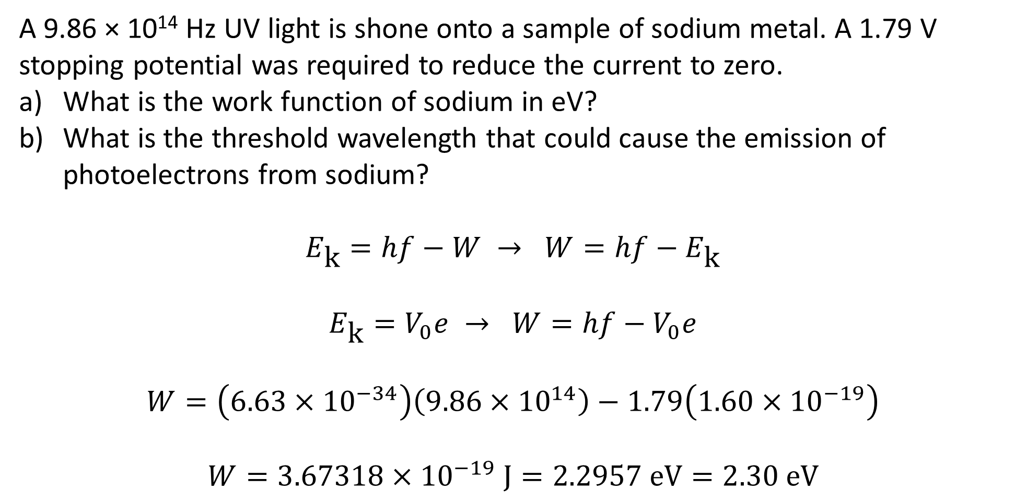
Example
A 9.86 × 10¹⁴ Hz UV light is shone onto a sample of sodium metal. A 1.79 V stopping potential was required to reduce the current to zero.
What is the work function of sodium in eV?
What is the threshold wavelength that could cause the emission of photoelectrons from sodium?
$$E_{\text{k}}=hf−W → W=hf−E_{\text{k}}$$
$$E_{\text{k}}=V_{0}e → W=hf−V_{0}e$$
$$W=\left(6.63×{10}^{−34}\right)\left(9.86×{10}^{14}\right)−1.79\left(1.60×{10}^{−19}\right)$$
$$W=3.67318×{10}^{−19} \text{J}=2.2957 \text{eV}=2.30 \text{eV}$$
Notes:
Alternatively:
Convert hf to eV (hf/e = 4.0857 eV)
1.79 V → 1.79 eV of kinetic energy
4.0857 – 1.79 = 2.30 eV

Slide 13
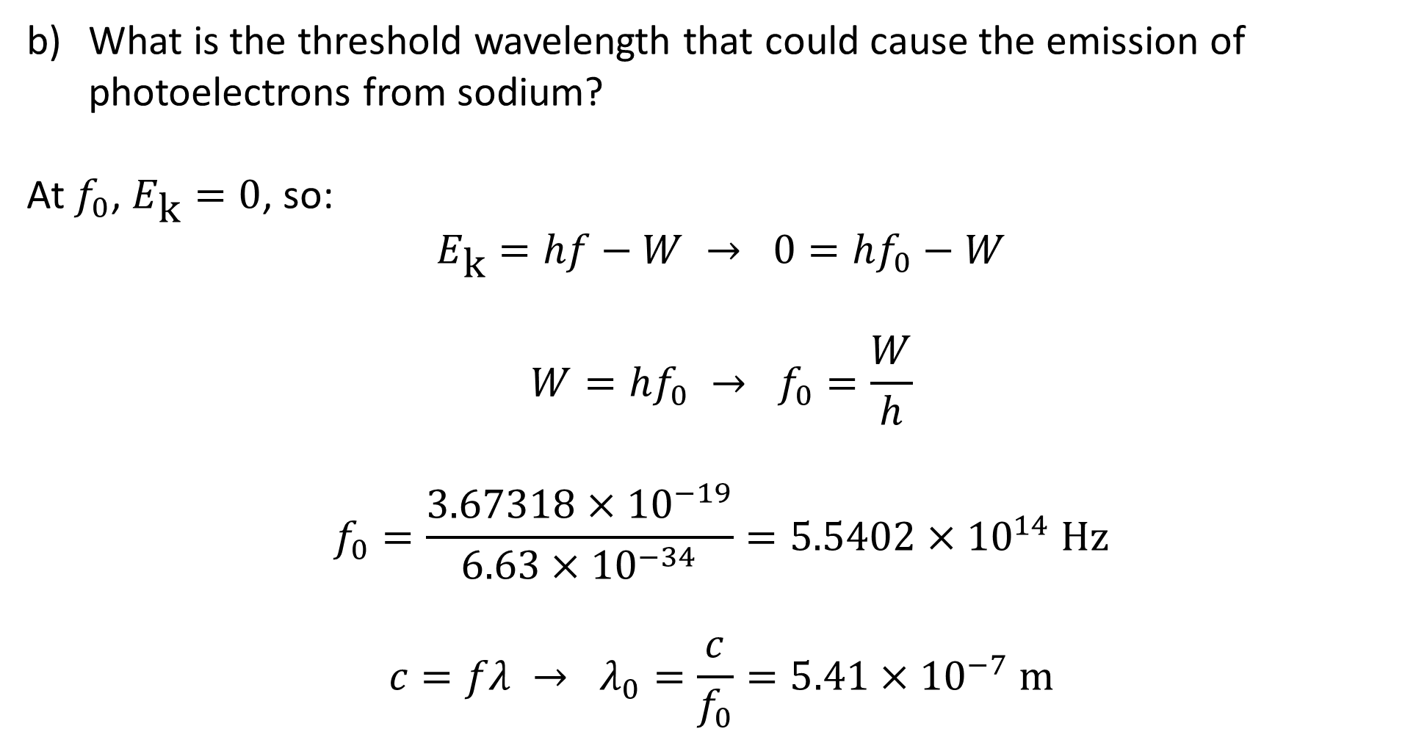
Example
What is the threshold wavelength that could cause the emission of photoelectrons from sodium?
At $f_{0}$, $E_{\text{k}}=0$, so:
$$E_{\text{k}}=hf−W → 0=hf_{0}−W$$
$$W=hf_{0} → f_{0}=\frac{W}{h}$$
$$f_{0}=\frac{3.67318×{10}^{−19}}{6.63×{10}^{−34}}=5.5402×{10}^{14} \text{Hz}$$
$$c=fλ → λ_{0}=\frac{c}{f_{0}}=5.41×{10}^{−7} \text{m}$$

